Slide 1
T3/Tutorials: Data Submission
Uploading phenotype data
https://triticeaetoolbox.org/

Slide 2
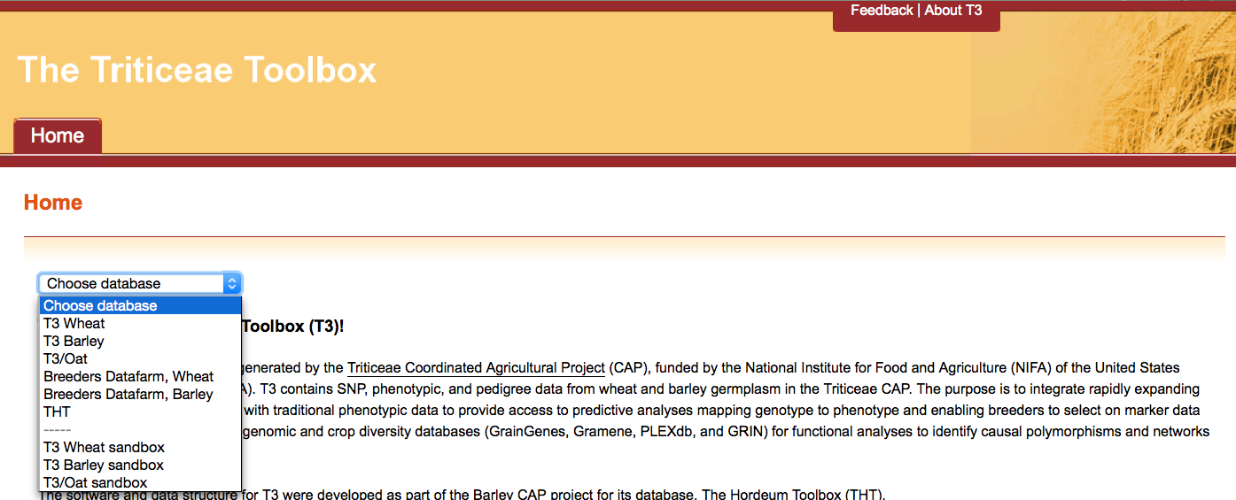
The Triticeae Toolbox (T3)
Each of the T3 databases can be reached from the T3 homepage: https://triticeaetoolbox.org
T3/Wheat will be used for demonstration purposes but these instructions are applicable to each instance of T3

Slide 3
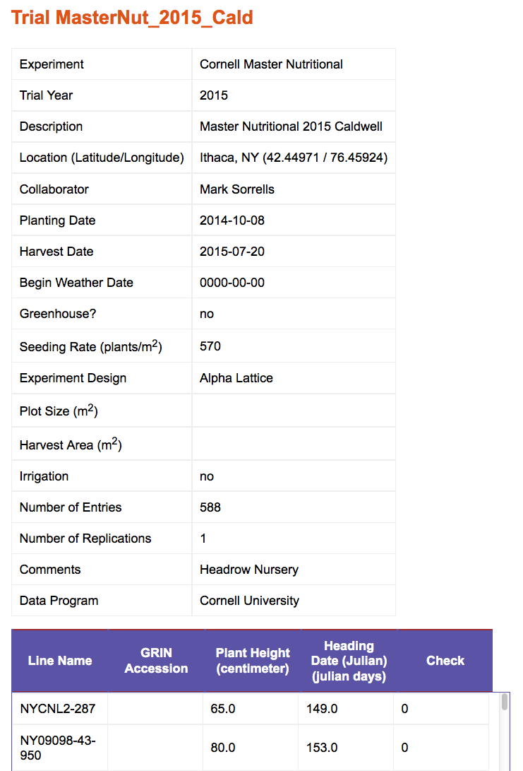
T3 phenotype trial reports
The trial name is the unique identifier for a T3 phenotype trial
Trial information must be uploaded first using one of the T3 data submission templates
Trial results can then be uploaded using a separate template
Additional raw data can also be attached to the trial record
Line information must be uploaded before trial results are submitted (see the T3 line submission tutorial)

Slide 4
Uploading Phenotype Data: Outline
Downloading the data submission templates
Completing the trial description template
Completing the trial means template
Test-loading the templates
Trial description template
Trial means template
Submitting the completed templates to T3

Slide 5
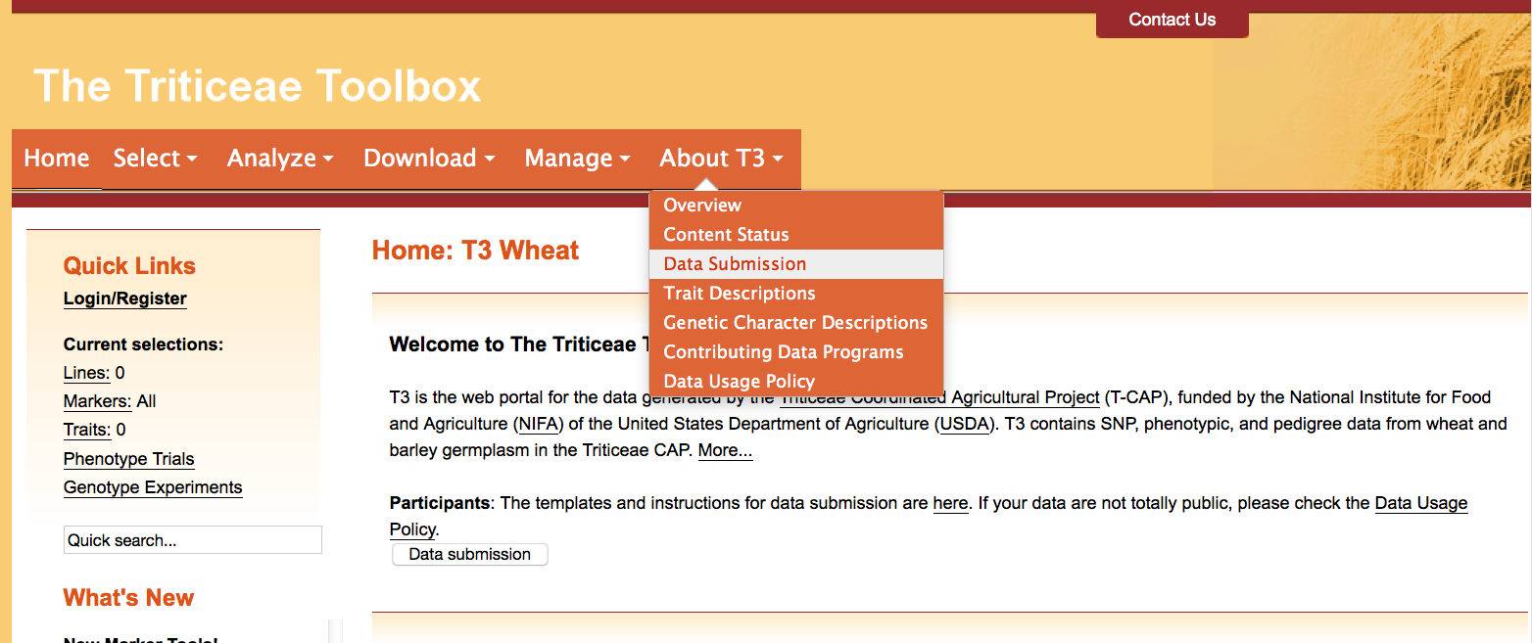
Section 1: Downloading the data submission templates
Navigate to the T3 database homepage of your choice
e.g. https://triticeaetoolbox.org/wheat/
Choose the About T3 menu > Data Submission

Slide 6
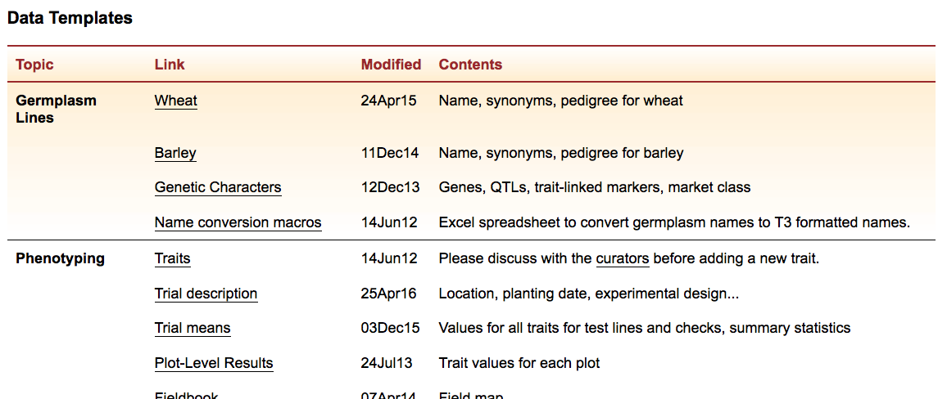
Section 1: Downloading the data submission templates
Select the “Trial description” and the “Trial means” data templates from the list to download these Excel templates

Slide 7
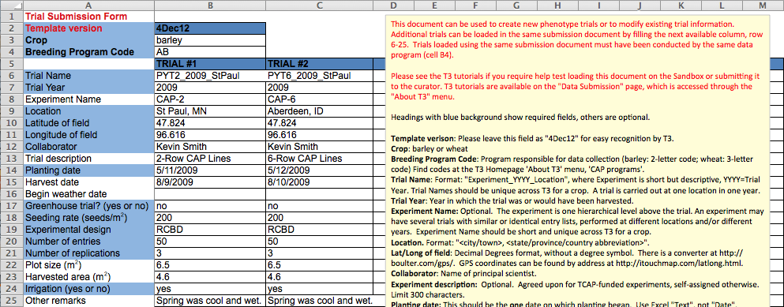
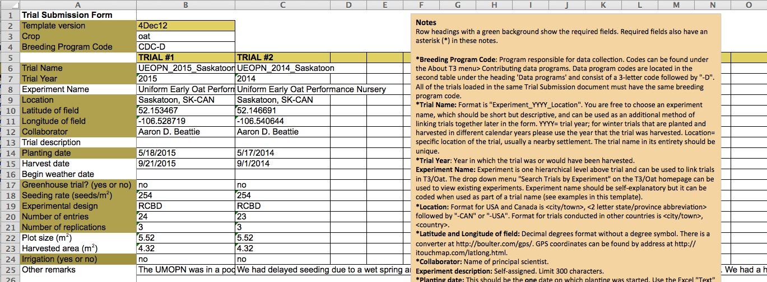
Section 2: Completing the trial description template
The notes section contains most of the information required to fill out the trial description template apart from the:
Breeding program code
Existing T3 experiment names
This information can be found under the “About T3” menu

Slide 8
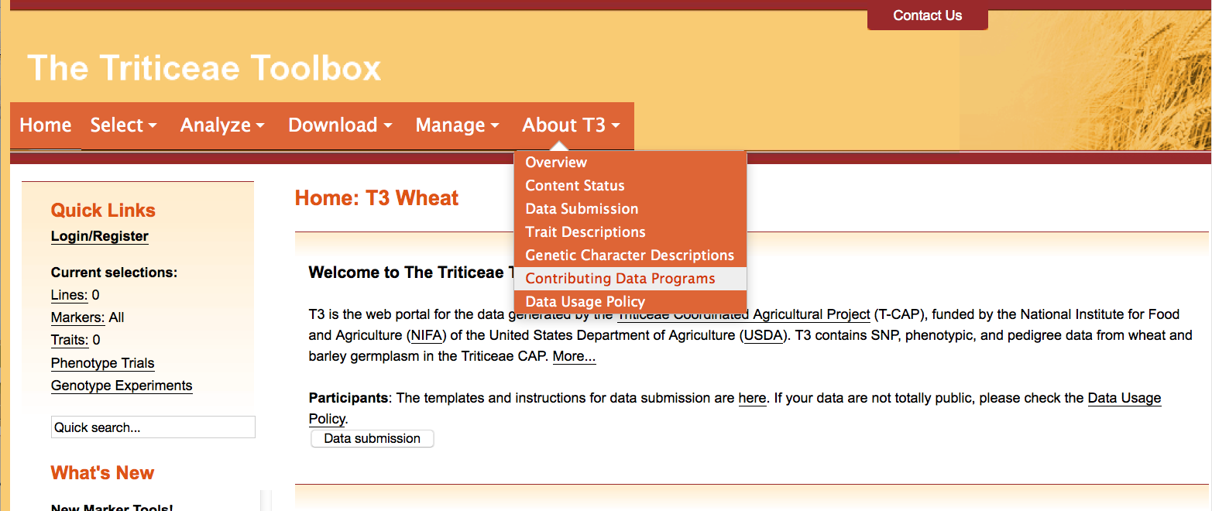
Section 2: Completing the trial description template
To find the appropriate data program code
Choose the About T3 menu > Contributing Data Programs

Slide 9
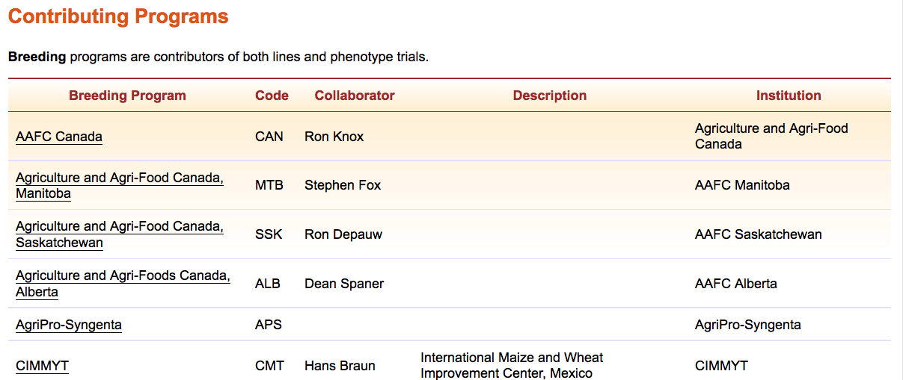
Section 2: Completing the trial description template
Breeding program codes can be found in the second column of the table on the “Contributing Programs” page
Contact the curator if you do not find an appropriate code

Slide 10
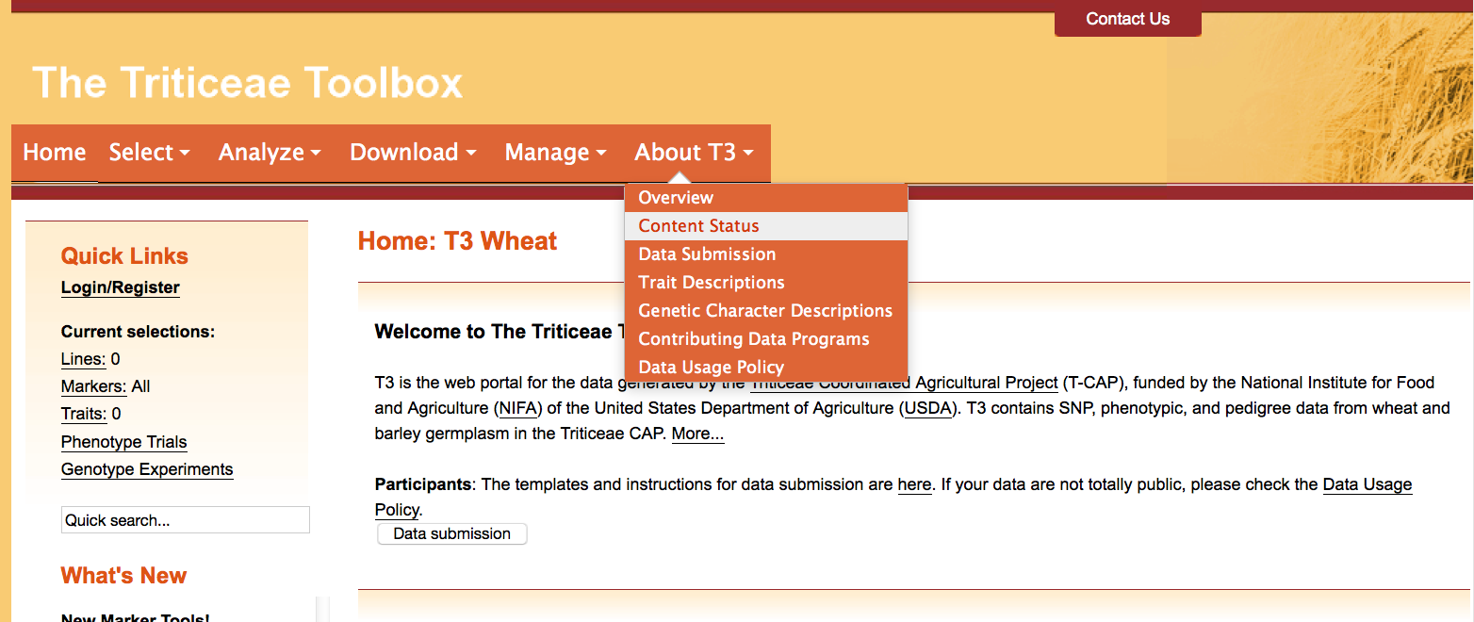
Section 2: Completing the trial description template
To find existing T3 experiment names
Choose the About T3 menu > Content Status

Slide 11
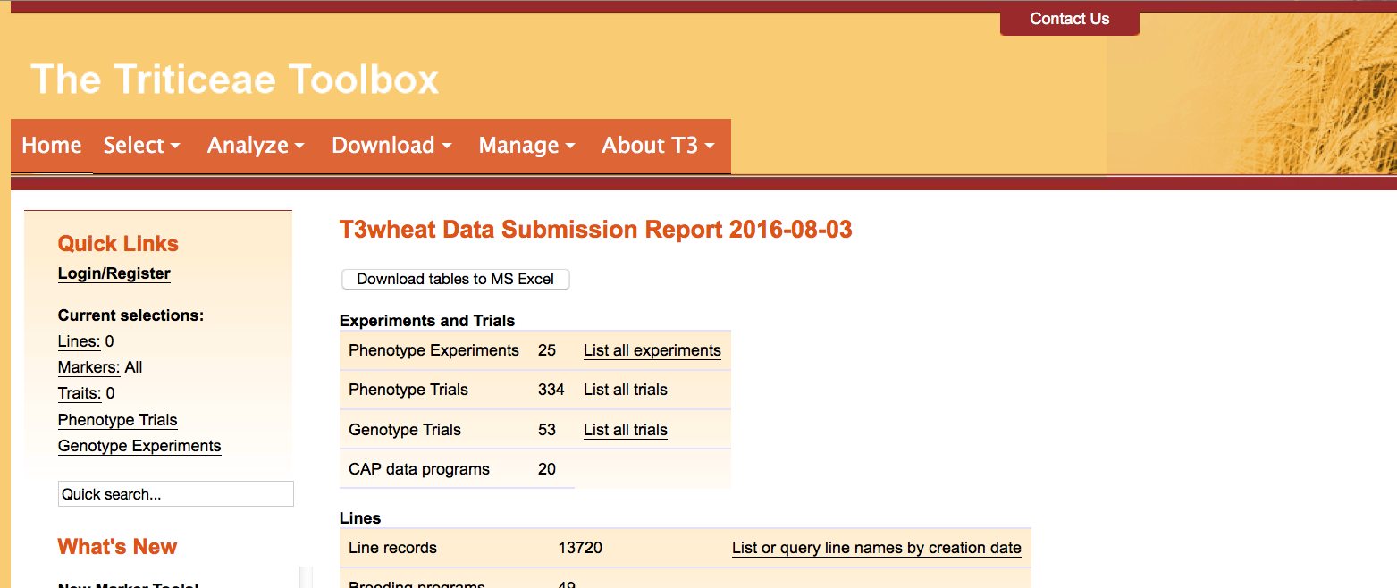
Section 2: Completing the trial description template
The Content Status page generates an up-to-date report that summarizes the content available in the database
Select “List all experiments” to generate a current list of experiments

Slide 12
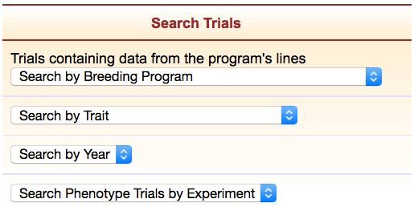
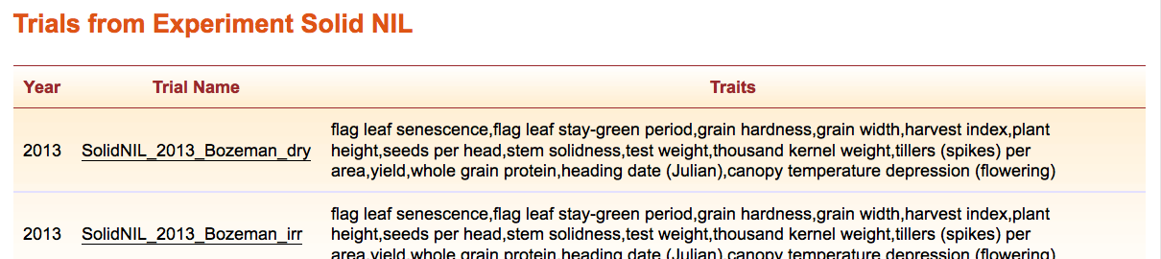
Section 2: Completing the trial description template
Experiments are used to link related phenotype trials in T3
Existing experiments are also listed on the homepage in the “Search Trials by Experiment” tool
This tool returns a list of trials within the selected experiment

Slide 13
Section 2: Completing the trial description template
Multiple trials can be loaded using a single submission document
All of the trials must be from the same data program
Each additional trial should fill the next available column
The notes box can be moved or removed from any T3 template

Slide 14
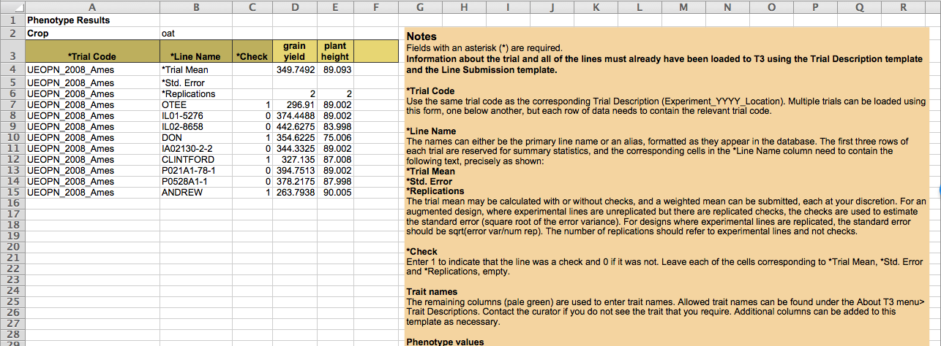
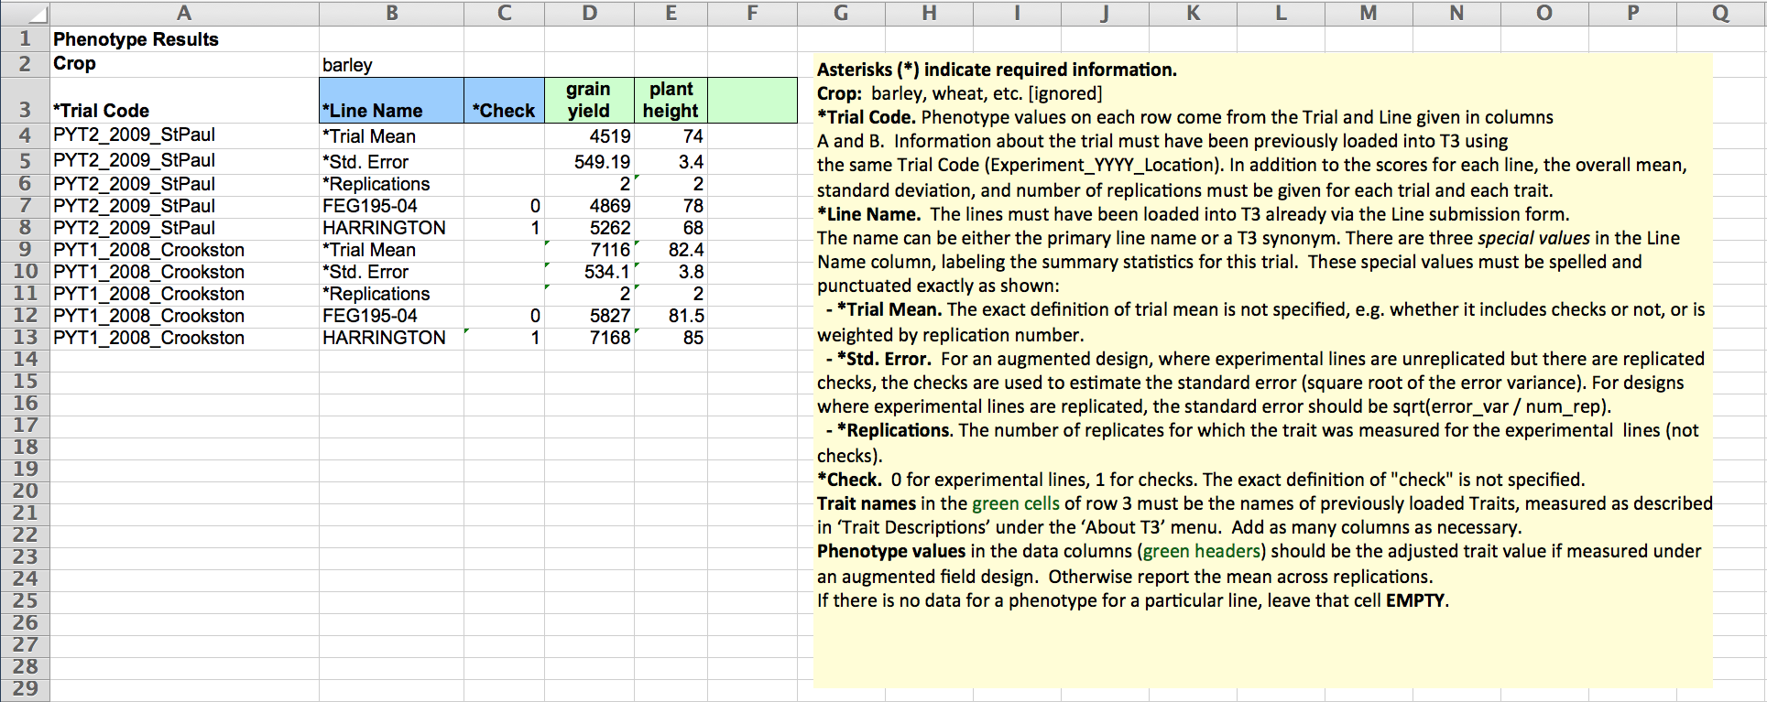
Section 3: Completing the trial means template
The notes section contains most of the information required to fill out the trial means template, apart from the:
Phenotype trait names (green headings)
This information can be found under the “About T3” menu

Slide 15

Section 3: Completing the trial means template
To find the phenotypic traits that are available in T3
Choose the About T3 menu > Trait Descriptions

Slide 16
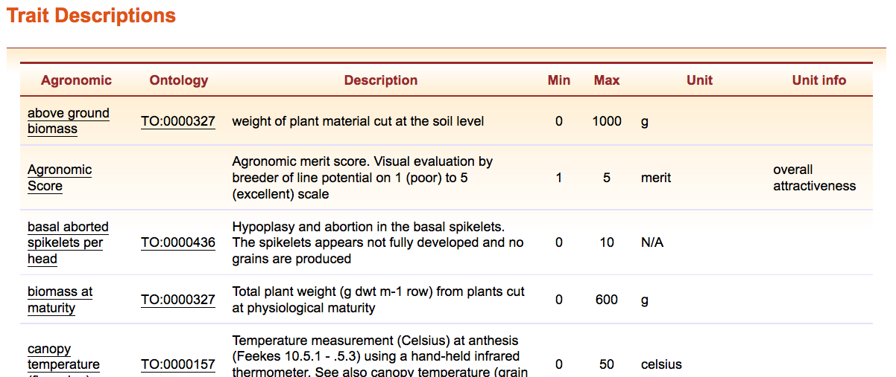
Section 3: Completing the trial means template
Use the phenotypic traits in the first column of the table as headings in the submission document
Take care to follow the exact formatting of the trait name
Contact the curator if you do not find an appropriate trait

Slide 17

Section 3: Completing the trial means template
The columns in the green section can be added to and removed as needed to provide trial means for any of the phenotypic traits listed in the “Trait Descriptions” table

Slide 18


Section 3: Completing the trial means template
Multiple trials can be loaded using a single submission document
Each row of data needs to contain the relevant trial name in the first column (*Trial code= trial name)
The trial name was created in the corresponding trial description template
The first three rows of each trial are reserved for the trial summary statistics

Slide 19
Section 3: Completing the trial means template
All line names submitted in this document must be present in the database. Please refer to the T3 line submission tutorial for instructions on how to:
Correctly format line names for T3
Search for existing T3 line records using “Select Lines by Properties”
Add new line records to T3

Slide 20
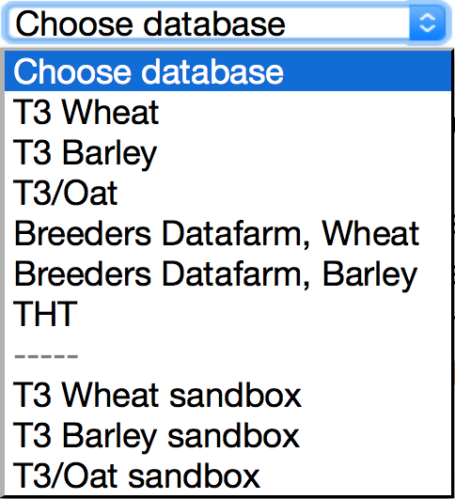
Section 4: Test-loading the templates
Each T3 database has a corresponding “sandbox”
Registered users can test-load data in these sandboxes
Data that is successfully uploaded to a sandbox can be submitted to the curator to be uploaded to the related production database
The production databases are the official repositories of T3 data
The sandboxes revert to an exact copy of the production databases each night

Slide 21
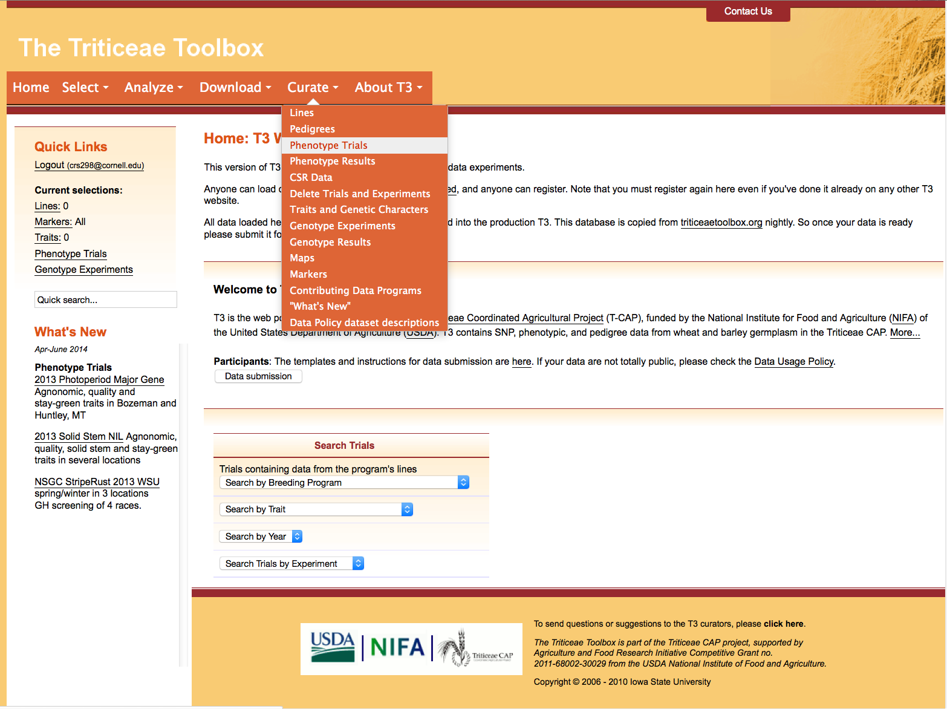
Section 4.1: Test-loading the trial description template
Navigate to the crop-specific T3 sandbox of your choice
e.g. https://t3sandbox.org/t3/sandbox/wheat/
The curation menu will appear once you register and login
Choose the Curate menu > Phenotype Trials

Slide 22
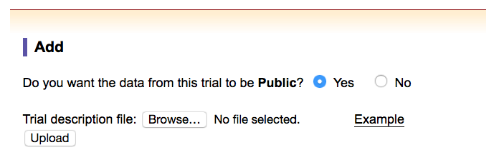
Section 4.1: Test-loading the trial description template
Select the completed trial description template to test-load it in the sandbox
It is possible to upload “private data” to T3
Private data is only visible to users that are designated as collaborators by the site administrators
Data may remain private for a limited time only
Please contact the curator if you are interested in this option

Slide 23
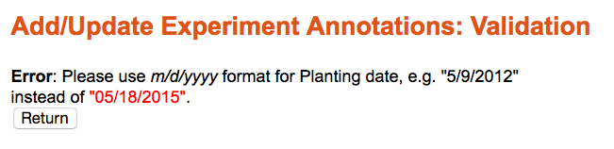
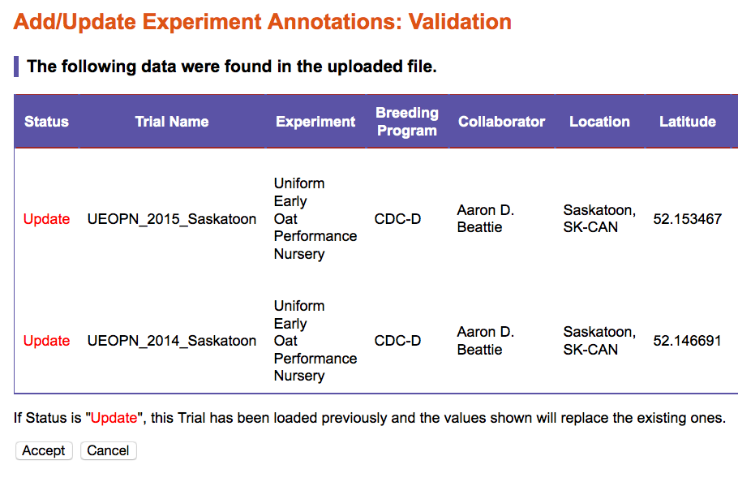
Section 4.1: Test-loading the trial description template
Any illegal entries in your uploaded file will be highlighted
e.g. incorrect date format
A validation window will appear that shows how T3 has read the upload document
Please take the time to validate your data
The first column indicates whether the trial is new to T3, or whether the upload will update existing trial information
Don’t forget to “Accept” the upload if the information is correct

Slide 24
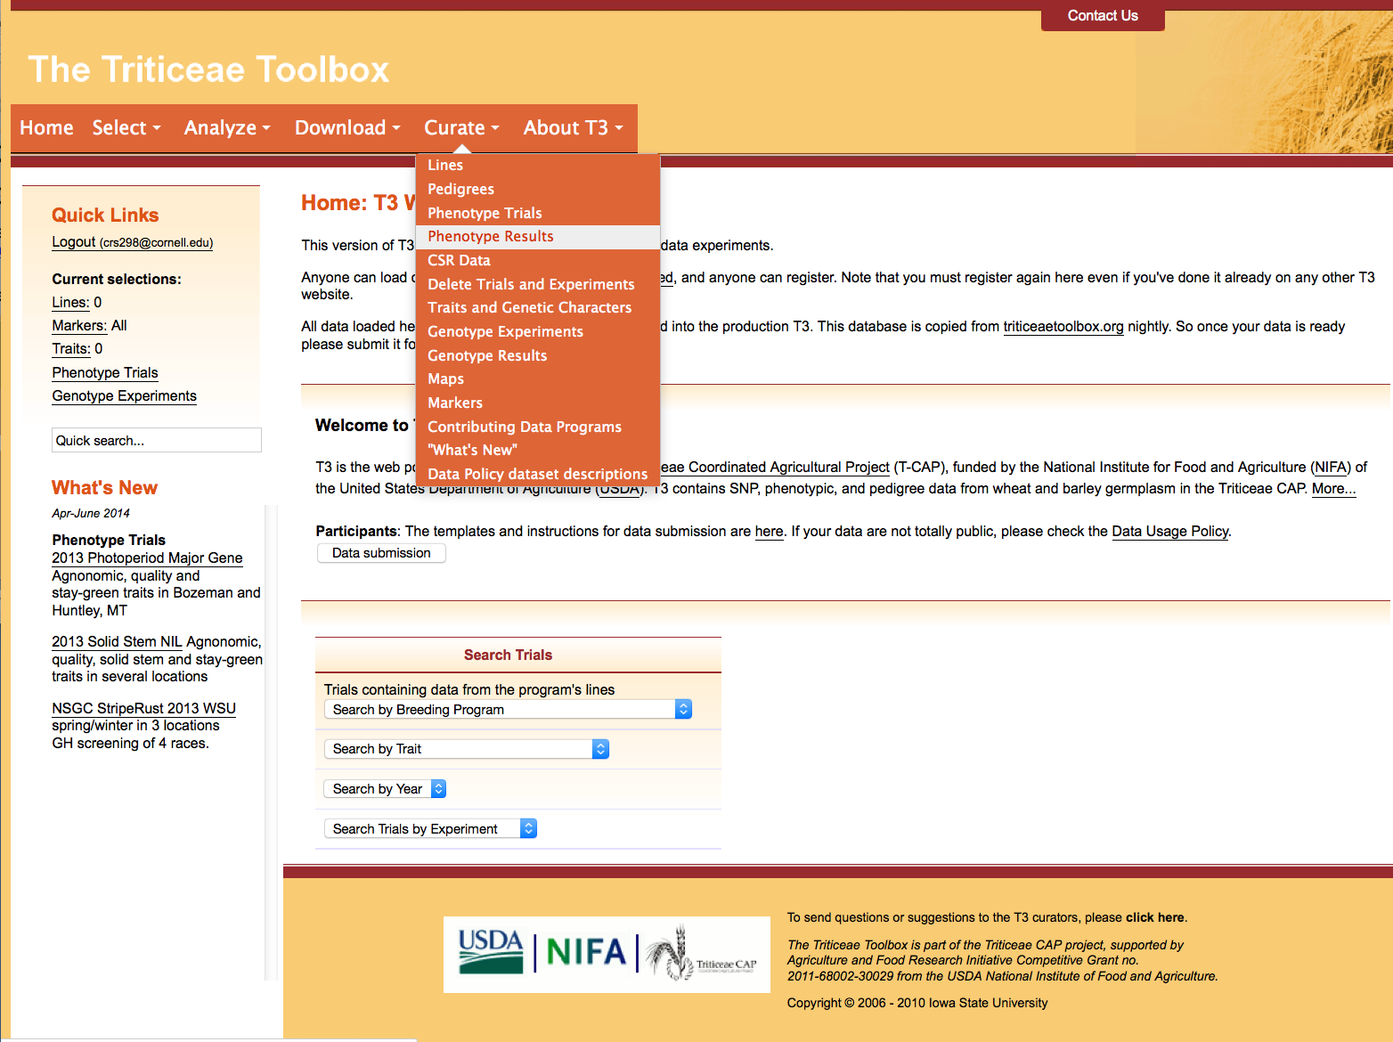
Section 4.1: Test-loading the trial description template
The trial means template can be test-loaded in the sandbox after the trial description template has been uploaded
Choose the Curate menu > Phenotype Results

Slide 25
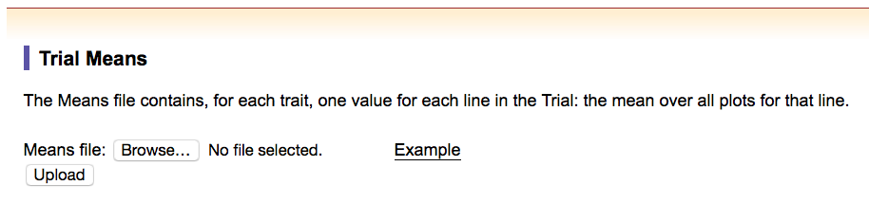
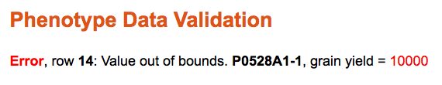
Section 4.2: Test-loading the trial means template
Select the completed trial means template to test-load it in the sandbox
Any illegal entries in your uploaded file will be highlighted
e.g. an out of bounds phenotype value

Slide 26
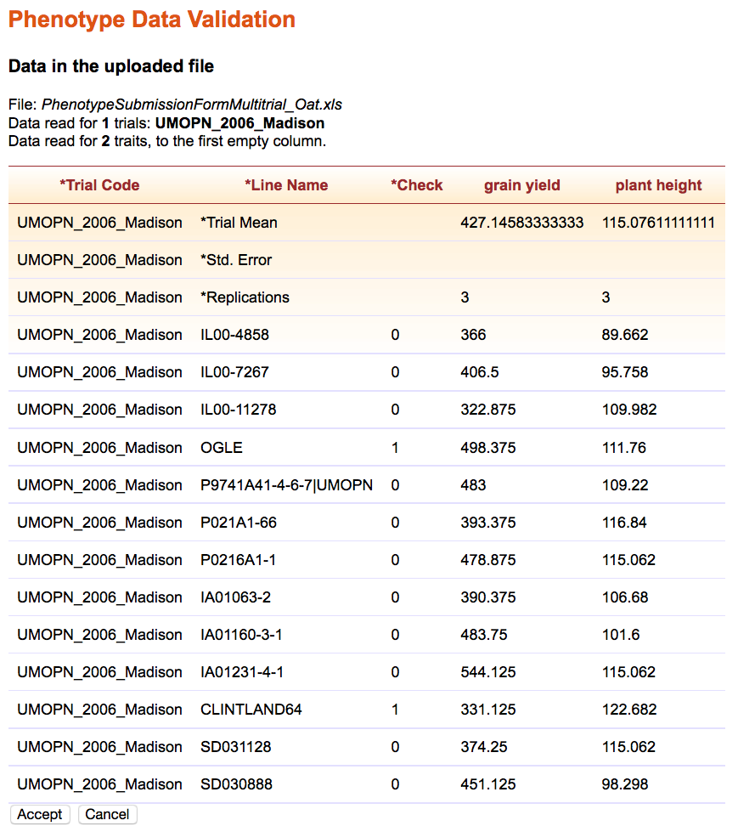
Section 4.2: Test-loading the trial means template
The “Phenotype Data Validation” step outlines how T3 has read the uploaded file
Please take the time to validate your data
Don’t forget to “Accept” the upload if the information is correct

Slide 27
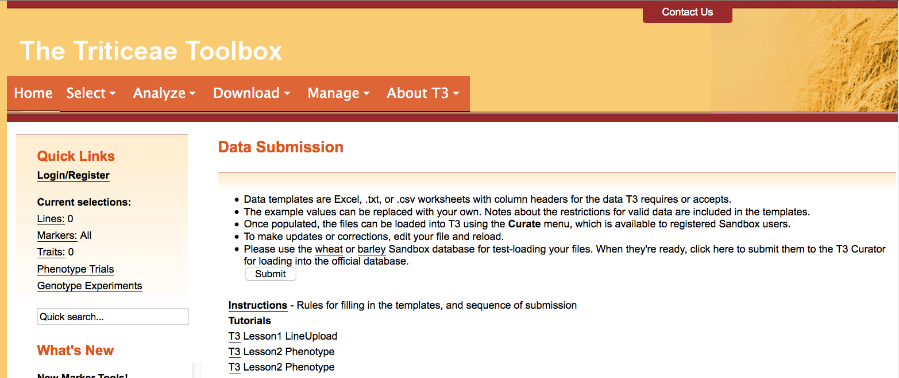
Section 5: Submitting the completed templates to T3
Finally, submit your documents to the curator for upload to T3
Login and then navigate to the “Data Submission” page
Click the “Submit” button

Slide 28
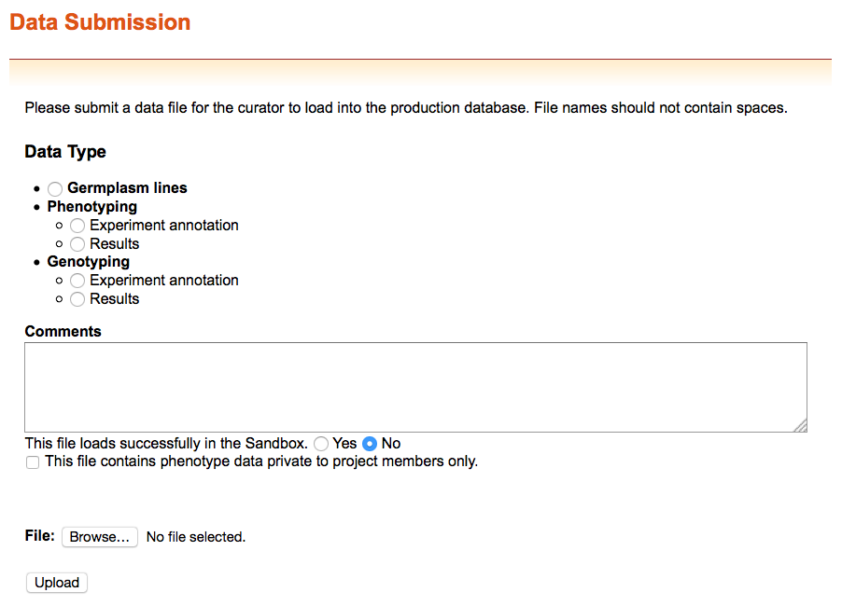
Section 5: Submitting the completed templates to T3
Indicate whether you are submitting:
an experiment annotation= trial description template
results= trial means template
Indicate whether the file uploaded successfully to the sandbox
Attach your completed template
You can submit files that do not successfully upload to the sandbox to receive help from the curator

Slide 29
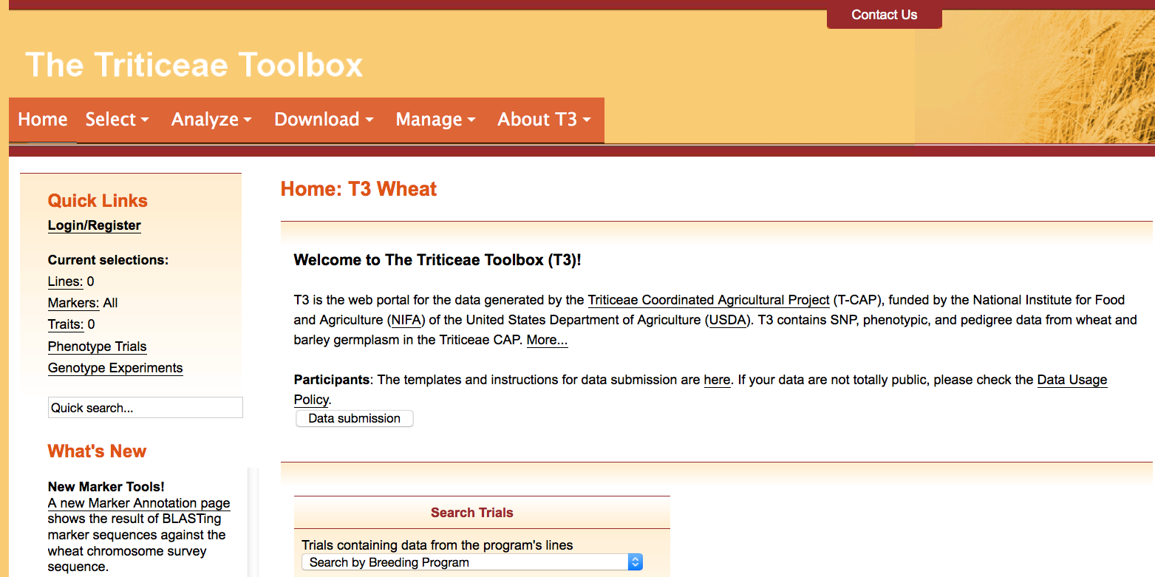
Contact Us
Please contact us if you need help using T3

